Slide 1
Work Experience Market Research
Matthew Vickery – D00190293 Joseph Dodd – D00281162

Slide 2
Types of companies
Large Multi-National: Large companies that operate in two or more countries.
SME (Small and Medium-sized Enterprises): Companies that have “fewer than 250 persons and which have an annual turnover not exceeding EUR 50 million, and/or an annual balance sheet total not exceeding EUR 43 million” (Gov.ie, 2025)
Start-up: Small newly created companies

Slide 3
Large Multi-National Companies
IBM: Technology Research, Charlemont Exchange, WeWork Office Space, Temple Bar, Dublin
Amazon: Shipping and entertainment, Burlington Rd, Dublin 4, D04 HH21
Prometric: Works on providing the official preparation material for the Road Safety Authority Driver Theory Test, Dundalk

Slide 4
SMEs Companies
DIGIT, a Scopely Studio: MMO and Strategy Game development, Multiplayer game management. Skilled with Unity3D, Python, and Engineering. Location: 4 Prince's Street South, Dublin, Dublin 2 IE

Slide 5
Start-up Companies

Slide 6
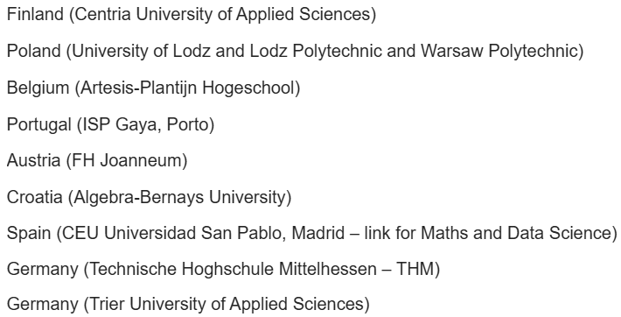


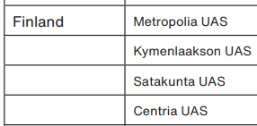
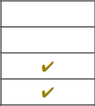
Erasmus
Fill out “Expression of interest” form.
Highlight where you want to go.
If on work placement, find accommodation yourself.
Or if at a University, on campus accommodations.
Each place has its own entry requirements.

Slide 7
Sources - 1
Gov.ie, 2025, Small Medium Enterprises (SMEs) [Online], Available from: https://www.gov.ie/en/office-of-government-procurement/publications/smes/ [Accessed 18th March 2026]

